Slide 1
Measuring Experience Part 1 Canada.ca February 15, 2018
Gerry McGovern
customercarewords.com

Slide 2
Quantifiable Metrics

Slide 3
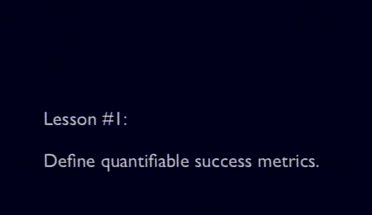
2012 Obama Campaign
“We made the new platform 60% faster and this resulted in a 14% increase in donation conversions.”
Notes:
Meet the Obama campaign's $250 million fundraising platform
Nov 27, 2012
The numbers
6 month life span
$250 million dollars, 4,276,463 donations
81,548,259 page views, 17,807,917 unique visitors
60% faster time to paint than previous platform
240 a/b tests, 49% increase in donation conversion rate
1,101 frontend deploys
4,000 lines of JavaScript
23% of traffic is mobile (including tablet)
The web stack
Static HTML pages generated by Jekyll
Served by Akamai CDN, origin hosted on Amazon S3
Version control with GitHub
Conversion optimization with Optimizely
LESS for CSS preprocessor, JavaScript compiled by CodeKit
Redundant, REST payment processor
Blue State Digital (vendor) API
Internal PHP based API, Amazon EC2 hosted
Building the new platform
When I first joined the Digital team at the Obama campaign back in June of 2011 the fundraising stakes were as high as they could get. There was speculation in the press that we would raise a jaw dropping $1 billion and while that seems like (and is) a lot of money, we were up against newly instituted Super PACs that could raise an unlimited amount of money (thanks Citizens United!). Not to mention that we would also eventually have a "businessman" opponent that would surely have a strong fundraising operation.
In the end though we astonished even ourselves by beating the expectations and raising $1.1 billion total. $690 million of that came through our various web properties. Because the competition was so steep and because we would be working at such scale, we knew we had to get very serious about our online fundraising platforms.
In the early days of the campaign (April 2011 - May of 2012) all of our online fundraising went through a single platform which was hosted and managed by one of our vendors, Blue State Digital (Blue State). This was a good platform for us at the time because it was easy for content managers to edit and produce fundraising pages without the help of our lone frontend engineer (me). Soon enough the campaign started hiring aggressively and that one frontend engineer turned into fourteen frontend engineers with six specifically focused on fundraising. By early 2012 we had the staff we needed to take our donation platform to the next level and we were certainly eager for the task.
Blue State was very helpful in working with us to create a new donation platform that met the campaign's unusual needs. We settled on a very simple solution of turning the hosted platform into a REST API. The only big change was adding JSON as an output option instead of HTML. Blue State was able to turn this around in only three days which was a huge win for the campaign because we were working on such a short timeline and already bringing in about $15 million a month. After this work was complete we had a very flexible donation API and now it was time to figure out what would consume it.
We knew from the very beginning that our new donation platform needed to be as fast as we could reasonably make it. We were very familiar with all the stories from huge companies like Amazon and Google about how only 100 milliseconds of latency can affect conversions by as much as 1%. Needless to say, performance was was one of our very top priorities.
After working closely with our Devops team to plan the architecture of the platform we decided to go static. We consumed the newly created donation API using JavaScript on static HTML pages which were served by our CDN (Akamai). We chose to do it this way in no small part because this is the fastest possible way to get the HTML document to the user since Akamai has over 50,000 edge servers and the system routes users to their closest server so that the file transfer time is extremely minimal. In our Chicago office we consistently saw HTML transfer times around 20 milliseconds!
Aside from performance, another high priority for the platform was stability. Our online fundraising tended to come in spurts based on what was happening in the news at the time or campaign fundraising emails. For example, our highest surge was $3 million an hour so any down time would have been very costly.
To ensure that the platform was as stable as possible we worked with backend engineers on the campaign's Tech team to make the Blue State API redundant. The Tech engineers built out a duplicate payment processor/API and hosted it on Amazon EC2 (itself redundant across data centers). At this point we had two APIs that we could switch between if one went down, but our Devops team had a great solution to make this automatic. They sprinkled a little Akamai magic and we had an Akamai health check which would automatically divert traffic to one API or the other based on the health check. By the time this was fully functional there was not a single moment in time that our new platform was not able to accept donations.
Testing the new platform
When all the infrastructure was complete we built an identical page on the new platform and compared it to the old platform. We were pretty blown away with the results. We used webpagetest.org to compare the performance between the two and Optimizely to test the conversion rate difference. We made the new platform 60% faster and this resulted in a 14% increase in donation conversions. In the screenshot below, we compared the time-to-paint between the two platforms on IE8 (the new platform is on top).
After we saw those results we launched the platform oncontribute.barackobama.com and it quickly became the source of most of the Digital team's fundraising. If you were browsing the site and clicked donate, donated from Facebook or Twitter or if you received a fundraising email from the campaign you probably landed on contribute.barackobama.com.
Once we had this platform in production we used Optimizely to execute about 240 a/b tests to optimize the design/interaction of the donation pages for better conversion rates. By the end of the campaign our 240 a/b tests lifted the donation conversion rate by 49%! Here is a comparison of what we started with and what we ended with (click for high res).
Looking back
Now that the campaign is over I've had some time to look back on the success of this platform and I can say with 100% certainty that this is the best development environment I have ever worked on. There are a lot of incredible numbers above on how we increased conversions with a/b testing and performance improvements, but I think one of the biggest accomplishments with this platform is the ROI it provided our entire team. By using Jekyll we managed to avoid the complexity that comes with most CMS (databases, server configuration) and instead focus on things like optimizing the UI and providing a better user experience. To work in this environment the most a frontend engineer had to learn was the Liquid template language that Jekyll uses and boy is that simple. We didn't have to work with Devops to deploy because all we had to do was overwrite files on S3 and invalidate a URL on our CDN. There is a lot to be said about simplicity.
If you haven't already, I suggest you go take a look at Jekyll. It's not perfect for every project, but when it makes sense it will make your life so much easier (and faster!).
What's the best part though? When we wake up January 21st, 2013, Barack Obama will still be President of the United States of America. Cheers!

Slide 4
2012 Obama Campaign
$250 million raised
Speed improvement cost: $1 million est.
Return: $33.6 million
ROI: 33
Notes:
Meet the Obama campaign's $250 million fundraising platform
Nov 27, 2012
The numbers
6 month life span
$250 million dollars, 4,276,463 donations
81,548,259 page views, 17,807,917 unique visitors
60% faster time to paint than previous platform
240 a/b tests, 49% increase in donation conversion rate
1,101 frontend deploys
4,000 lines of JavaScript
23% of traffic is mobile (including tablet)
The web stack
Static HTML pages generated by Jekyll
Served by Akamai CDN, origin hosted on Amazon S3
Version control with GitHub
Conversion optimization with Optimizely
LESS for CSS preprocessor, JavaScript compiled by CodeKit
Redundant, REST payment processor
Blue State Digital (vendor) API
Internal PHP based API, Amazon EC2 hosted
Building the new platform
When I first joined the Digital team at the Obama campaign back in June of 2011 the fundraising stakes were as high as they could get. There was speculation in the press that we would raise a jaw dropping $1 billion and while that seems like (and is) a lot of money, we were up against newly instituted Super PACs that could raise an unlimited amount of money (thanks Citizens United!). Not to mention that we would also eventually have a "businessman" opponent that would surely have a strong fundraising operation.
In the end though we astonished even ourselves by beating the expectations and raising $1.1 billion total. $690 million of that came through our various web properties. Because the competition was so steep and because we would be working at such scale, we knew we had to get very serious about our online fundraising platforms.
In the early days of the campaign (April 2011 - May of 2012) all of our online fundraising went through a single platform which was hosted and managed by one of our vendors, Blue State Digital (Blue State). This was a good platform for us at the time because it was easy for content managers to edit and produce fundraising pages without the help of our lone frontend engineer (me). Soon enough the campaign started hiring aggressively and that one frontend engineer turned into fourteen frontend engineers with six specifically focused on fundraising. By early 2012 we had the staff we needed to take our donation platform to the next level and we were certainly eager for the task.
Blue State was very helpful in working with us to create a new donation platform that met the campaign's unusual needs. We settled on a very simple solution of turning the hosted platform into a REST API. The only big change was adding JSON as an output option instead of HTML. Blue State was able to turn this around in only three days which was a huge win for the campaign because we were working on such a short timeline and already bringing in about $15 million a month. After this work was complete we had a very flexible donation API and now it was time to figure out what would consume it.
We knew from the very beginning that our new donation platform needed to be as fast as we could reasonably make it. We were very familiar with all the stories from huge companies like Amazon and Google about how only 100 milliseconds of latency can affect conversions by as much as 1%. Needless to say, performance was was one of our very top priorities.
After working closely with our Devops team to plan the architecture of the platform we decided to go static. We consumed the newly created donation API using JavaScript on static HTML pages which were served by our CDN (Akamai). We chose to do it this way in no small part because this is the fastest possible way to get the HTML document to the user since Akamai has over 50,000 edge servers and the system routes users to their closest server so that the file transfer time is extremely minimal. In our Chicago office we consistently saw HTML transfer times around 20 milliseconds!
Aside from performance, another high priority for the platform was stability. Our online fundraising tended to come in spurts based on what was happening in the news at the time or campaign fundraising emails. For example, our highest surge was $3 million an hour so any down time would have been very costly.
To ensure that the platform was as stable as possible we worked with backend engineers on the campaign's Tech team to make the Blue State API redundant. The Tech engineers built out a duplicate payment processor/API and hosted it on Amazon EC2 (itself redundant across data centers). At this point we had two APIs that we could switch between if one went down, but our Devops team had a great solution to make this automatic. They sprinkled a little Akamai magic and we had an Akamai health check which would automatically divert traffic to one API or the other based on the health check. By the time this was fully functional there was not a single moment in time that our new platform was not able to accept donations.
Testing the new platform
When all the infrastructure was complete we built an identical page on the new platform and compared it to the old platform. We were pretty blown away with the results. We used webpagetest.org to compare the performance between the two and Optimizely to test the conversion rate difference. We made the new platform 60% faster and this resulted in a 14% increase in donation conversions. In the screenshot below, we compared the time-to-paint between the two platforms on IE8 (the new platform is on top).
After we saw those results we launched the platform oncontribute.barackobama.com and it quickly became the source of most of the Digital team's fundraising. If you were browsing the site and clicked donate, donated from Facebook or Twitter or if you received a fundraising email from the campaign you probably landed on contribute.barackobama.com.
Once we had this platform in production we used Optimizely to execute about 240 a/b tests to optimize the design/interaction of the donation pages for better conversion rates. By the end of the campaign our 240 a/b tests lifted the donation conversion rate by 49%! Here is a comparison of what we started with and what we ended with (click for high res).
Looking back
Now that the campaign is over I've had some time to look back on the success of this platform and I can say with 100% certainty that this is the best development environment I have ever worked on. There are a lot of incredible numbers above on how we increased conversions with a/b testing and performance improvements, but I think one of the biggest accomplishments with this platform is the ROI it provided our entire team. By using Jekyll we managed to avoid the complexity that comes with most CMS (databases, server configuration) and instead focus on things like optimizing the UI and providing a better user experience. To work in this environment the most a frontend engineer had to learn was the Liquid template language that Jekyll uses and boy is that simple. We didn't have to work with Devops to deploy because all we had to do was overwrite files on S3 and invalidate a URL on our CDN. There is a lot to be said about simplicity.
If you haven't already, I suggest you go take a look at Jekyll. It's not perfect for every project, but when it makes sense it will make your life so much easier (and faster!).
What's the best part though? When we wake up January 21st, 2013, Barack Obama will still be President of the United States of America. Cheers!

Slide 5
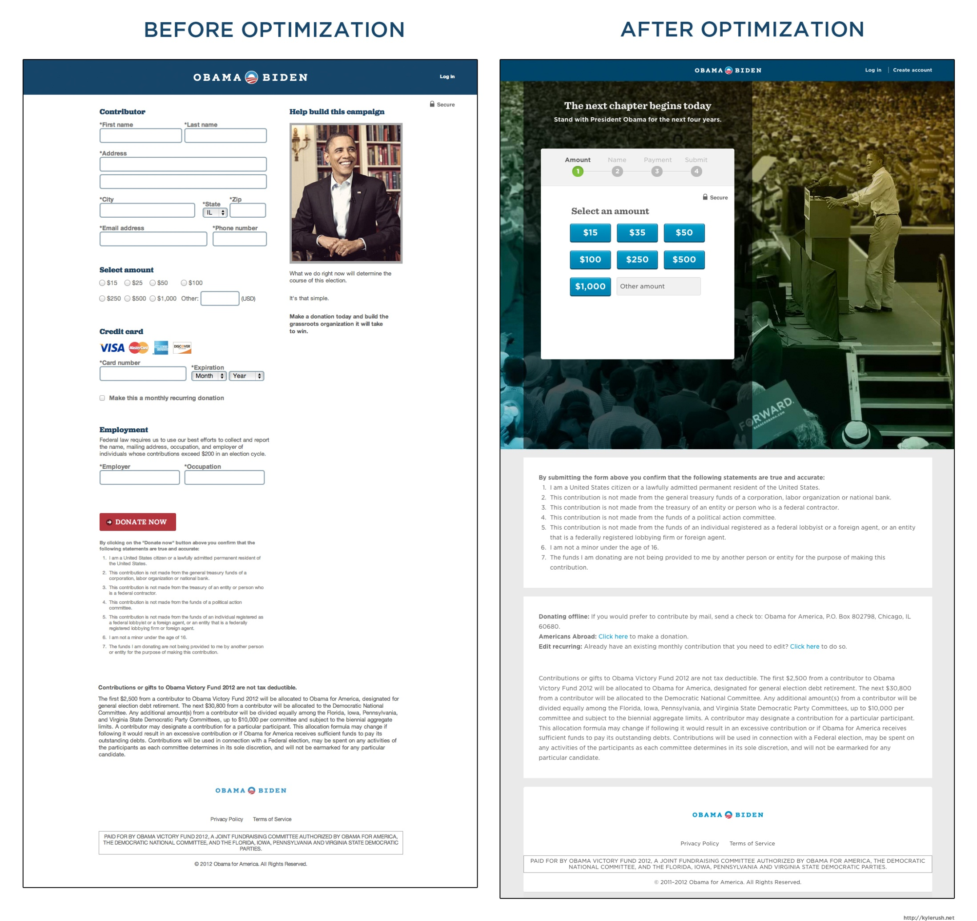
$250MILLION
“By the end of the campaign our 240 a/b tests lifted the donation conversion rate by 49%!”
Notes:
Meet the Obama campaign's $250 million fundraising platform
Nov 27, 2012
The numbers
6 month life span
$250 million dollars, 4,276,463 donations
81,548,259 page views, 17,807,917 unique visitors
60% faster time to paint than previous platform
240 a/b tests, 49% increase in donation conversion rate
1,101 frontend deploys
4,000 lines of JavaScript
23% of traffic is mobile (including tablet)
The web stack
Static HTML pages generated by Jekyll
Served by Akamai CDN, origin hosted on Amazon S3
Version control with GitHub
Conversion optimization with Optimizely
LESS for CSS preprocessor, JavaScript compiled by CodeKit
Redundant, REST payment processor
Blue State Digital (vendor) API
Internal PHP based API, Amazon EC2 hosted
Building the new platform
When I first joined the Digital team at the Obama campaign back in June of 2011 the fundraising stakes were as high as they could get. There was speculation in the press that we would raise a jaw dropping $1 billion and while that seems like (and is) a lot of money, we were up against newly instituted Super PACs that could raise an unlimited amount of money (thanks Citizens United!). Not to mention that we would also eventually have a "businessman" opponent that would surely have a strong fundraising operation.
In the end though we astonished even ourselves by beating the expectations and raising $1.1 billion total. $690 million of that came through our various web properties. Because the competition was so steep and because we would be working at such scale, we knew we had to get very serious about our online fundraising platforms.
In the early days of the campaign (April 2011 - May of 2012) all of our online fundraising went through a single platform which was hosted and managed by one of our vendors, Blue State Digital (Blue State). This was a good platform for us at the time because it was easy for content managers to edit and produce fundraising pages without the help of our lone frontend engineer (me). Soon enough the campaign started hiring aggressively and that one frontend engineer turned into fourteen frontend engineers with six specifically focused on fundraising. By early 2012 we had the staff we needed to take our donation platform to the next level and we were certainly eager for the task.
Blue State was very helpful in working with us to create a new donation platform that met the campaign's unusual needs. We settled on a very simple solution of turning the hosted platform into a REST API. The only big change was adding JSON as an output option instead of HTML. Blue State was able to turn this around in only three days which was a huge win for the campaign because we were working on such a short timeline and already bringing in about $15 million a month. After this work was complete we had a very flexible donation API and now it was time to figure out what would consume it.
We knew from the very beginning that our new donation platform needed to be as fast as we could reasonably make it. We were very familiar with all the stories from huge companies like Amazon and Google about how only 100 milliseconds of latency can affect conversions by as much as 1%. Needless to say, performance was one of our very top priorities.
After working closely with our Devops team to plan the architecture of the platform we decided to go static. We consumed the newly created donation API using JavaScript on static HTML pages which were served by our CDN (Akamai). We chose to do it this way in no small part because this is the fastest possible way to get the HTML document to the user since Akamai has over 50,000 edge servers and the system routes users to their closest server so that the file transfer time is extremely minimal. In our Chicago office we consistently saw HTML transfer times around 20 milliseconds!
Aside from performance, another high priority for the platform was stability. Our online fundraising tended to come in spurts based on what was happening in the news at the time or campaign fundraising emails. For example, our highest surge was $3 million an hour so any down time would have been very costly.
To ensure that the platform was as stable as possible we worked with backend engineers on the campaign's Tech team to make the Blue State API redundant. The Tech engineers built out a duplicate payment processor/API and hosted it on Amazon EC2 (itself redundant across data centers). At this point we had two APIs that we could switch between if one went down, but our Devops team had a great solution to make this automatic. They sprinkled a little Akamai magic and we had an Akamai health check which would automatically divert traffic to one API or the other based on the health check. By the time this was fully functional there was not a single moment in time that our new platform was not able to accept donations.
Testing the new platform
When all the infrastructure was complete we built an identical page on the new platform and compared it to the old platform. We were pretty blown away with the results. We used webpagetest.org to compare the performance between the two and Optimizely to test the conversion rate difference. We made the new platform 60% faster and this resulted in a 14% increase in donation conversions. In the screenshot below, we compared the time-to-paint between the two platforms on IE8 (the new platform is on top).
After we saw those results we launched the platform oncontribute.barackobama.com and it quickly became the source of most of the Digital team's fundraising. If you were browsing the site and clicked donate, donated from Facebook or Twitter or if you received a fundraising email from the campaign you probably landed on contribute.barackobama.com.
Once we had this platform in production we used Optimizely to execute about 240 a/b tests to optimize the design/interaction of the donation pages for better conversion rates. By the end of the campaign our 240 a/b tests lifted the donation conversion rate by 49%! Here is a comparison of what we started with and what we ended with (click for high res).
Looking back
Now that the campaign is over I've had some time to look back on the success of this platform and I can say with 100% certainty that this is the best development environment I have ever worked on. There are a lot of incredible numbers above on how we increased conversions with a/b testing and performance improvements, but I think one of the biggest accomplishments with this platform is the ROI it provided our entire team. By using Jekyll we managed to avoid the complexity that comes with most CMS (databases, server configuration) and instead focus on things like optimizing the UI and providing a better user experience. To work in this environment the most a frontend engineer had to learn was the Liquid template language that Jekyll uses and boy is that simple. We didn't have to work with Devops to deploy because all we had to do was overwrite files on S3 and invalidate a URL on our CDN. There is a lot to be said about simplicity.
If you haven't already, I suggest you go take a look at Jekyll. It's not perfect for every project, but when it makes sense it will make your life so much easier (and faster!).
What's the best part though? When we wake up January 21st, 2013, Barack Obama will still be President of the United States of America. Cheers!

Slide 6
2012 Obama Campaign
6 month campaign
180 days
240 optimizations
1.3 optimizations per day
$70 million more because of optimization
Notes:
Meet the Obama campaign's $250 million fundraising platform
Nov 27, 2012
The numbers
6 month life span
$250 million dollars, 4,276,463 donations
81,548,259 page views, 17,807,917 unique visitors
60% faster time to paint than previous platform
240 a/b tests, 49% increase in donation conversion rate
1,101 frontend deploys
4,000 lines of JavaScript
23% of traffic is mobile (including tablet)
The web stack
Static HTML pages generated by Jekyll
Served by Akamai CDN, origin hosted on Amazon S3
Version control with GitHub
Conversion optimization with Optimizely
LESS for CSS preprocessor, JavaScript compiled by CodeKit
Redundant, REST payment processor
Blue State Digital (vendor) API
Internal PHP based API, Amazon EC2 hosted
Building the new platform
When I first joined the Digital team at the Obama campaign back in June of 2011 the fundraising stakes were as high as they could get. There was speculation in the press that we would raise a jaw dropping $1 billion and while that seems like (and is) a lot of money, we were up against newly instituted Super PACs that could raise an unlimited amount of money (thanks Citizens United!). Not to mention that we would also eventually have a "businessman" opponent that would surely have a strong fundraising operation.
In the end though we astonished even ourselves by beating the expectations and raising $1.1 billion total. $690 million of that came through our various web properties. Because the competition was so steep and because we would be working at such scale, we knew we had to get very serious about our online fundraising platforms.
In the early days of the campaign (April 2011 - May of 2012) all of our online fundraising went through a single platform which was hosted and managed by one of our vendors, Blue State Digital (Blue State). This was a good platform for us at the time because it was easy for content managers to edit and produce fundraising pages without the help of our lone frontend engineer (me). Soon enough the campaign started hiring aggressively and that one frontend engineer turned into fourteen frontend engineers with six specifically focused on fundraising. By early 2012 we had the staff we needed to take our donation platform to the next level and we were certainly eager for the task.
Blue State was very helpful in working with us to create a new donation platform that met the campaign's unusual needs. We settled on a very simple solution of turning the hosted platform into a REST API. The only big change was adding JSON as an output option instead of HTML. Blue State was able to turn this around in only three days which was a huge win for the campaign because we were working on such a short timeline and already bringing in about $15 million a month. After this work was complete we had a very flexible donation API and now it was time to figure out what would consume it.
We knew from the very beginning that our new donation platform needed to be as fast as we could reasonably make it. We were very familiar with all the stories from huge companies like Amazon and Google about how only 100 milliseconds of latency can affect conversions by as much as 1%. Needless to say, performance was was one of our very top priorities.
After working closely with our Devops team to plan the architecture of the platform we decided to go static. We consumed the newly created donation API using JavaScript on static HTML pages which were served by our CDN (Akamai). We chose to do it this way in no small part because this is the fastest possible way to get the HTML document to the user since Akamai has over 50,000 edge servers and the system routes users to their closest server so that the file transfer time is extremely minimal. In our Chicago office we consistently saw HTML transfer times around 20 milliseconds!
Aside from performance, another high priority for the platform was stability. Our online fundraising tended to come in spurts based on what was happening in the news at the time or campaign fundraising emails. For example, our highest surge was $3 million an hour so any down time would have been very costly.
To ensure that the platform was as stable as possible we worked with backend engineers on the campaign's Tech team to make the Blue State API redundant. The Tech engineers built out a duplicate payment processor/API and hosted it on Amazon EC2 (itself redundant across data centers). At this point we had two APIs that we could switch between if one went down, but our Devops team had a great solution to make this automatic. They sprinkled a little Akamai magic and we had an Akamai health check which would automatically divert traffic to one API or the other based on the health check. By the time this was fully functional there was not a single moment in time that our new platform was not able to accept donations.
Testing the new platform
When all the infrastructure was complete we built an identical page on the new platform and compared it to the old platform. We were pretty blown away with the results. We used webpagetest.org to compare the performance between the two and Optimizely to test the conversion rate difference. We made the new platform 60% faster and this resulted in a 14% increase in donation conversions. In the screenshot below, we compared the time-to-paint between the two platforms on IE8 (the new platform is on top).
After we saw those results we launched the platform oncontribute.barackobama.com and it quickly became the source of most of the Digital team's fundraising. If you were browsing the site and clicked donate, donated from Facebook or Twitter or if you received a fundraising email from the campaign you probably landed on contribute.barackobama.com.
Once we had this platform in production we used Optimizely to execute about 240 a/b tests to optimize the design/interaction of the donation pages for better conversion rates. By the end of the campaign our 240 a/b tests lifted the donation conversion rate by 49%! Here is a comparison of what we started with and what we ended with (click for high res).
Looking back
Now that the campaign is over I've had some time to look back on the success of this platform and I can say with 100% certainty that this is the best development environment I have ever worked on. There are a lot of incredible numbers above on how we increased conversions with a/b testing and performance improvements, but I think one of the biggest accomplishments with this platform is the ROI it provided our entire team. By using Jekyll we managed to avoid the complexity that comes with most CMS (databases, server configuration) and instead focus on things like optimizing the UI and providing a better user experience. To work in this environment the most a frontend engineer had to learn was the Liquid template language that Jekyll uses and boy is that simple. We didn't have to work with Devops to deploy because all we had to do was overwrite files on S3 and invalidate a URL on our CDN. There is a lot to be said about simplicity.
If you haven't already, I suggest you go take a look at Jekyll. It's not perfect for every project, but when it makes sense it will make your life so much easier (and faster!).
What's the best part though? When we wake up January 21st, 2013, Barack Obama will still be President of the United States of America. Cheers!

Slide 7
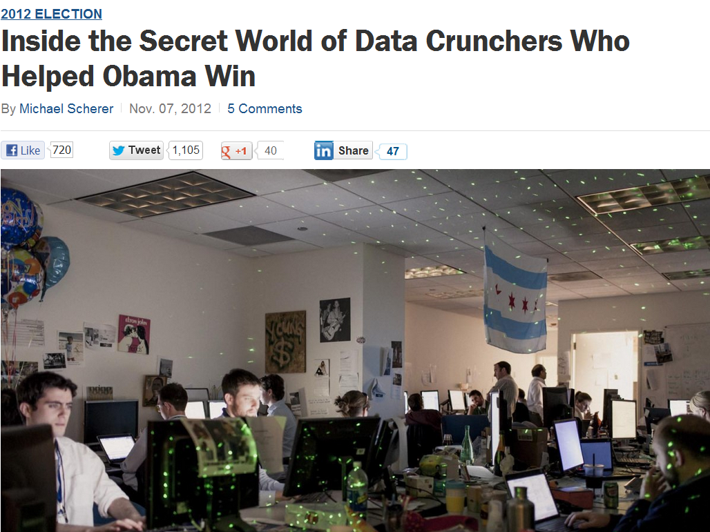
“The time of guys sitting in a back room smoking cigars is over”

Slide 8
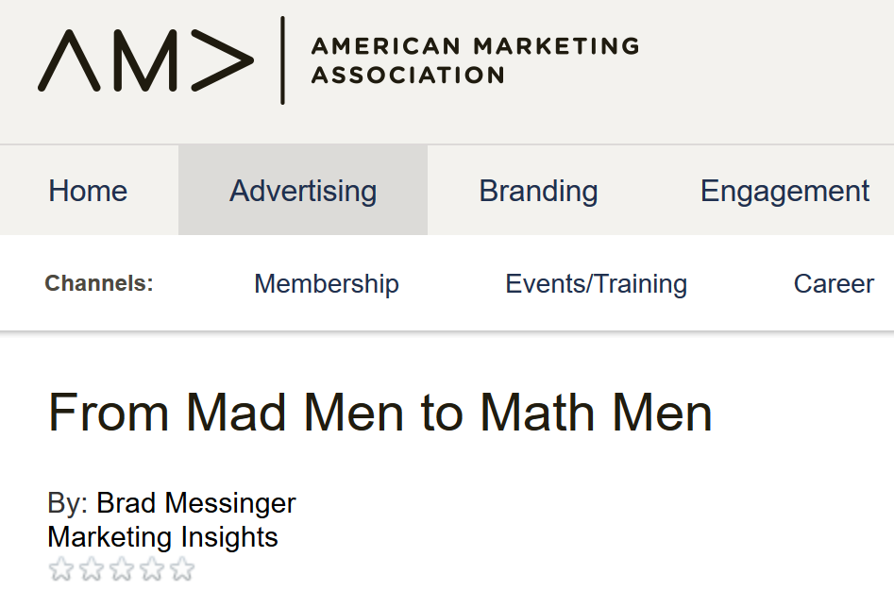
Notes:
Modern day marketing demands right-brain thinking with a left-brain approach
Suits, scotch and cigarettes come to mind when many people think about professionals in the marketing industry. While the 1960s’ depiction of the advertising industry shown in the AMC TV show Mad Men has garnered widespread critical acclaim, when compared to today’s actual marketing landscape, the show no longer represents reality. The role of marketing has truly changed. The creativity and storytelling that is often associated with advertising and marketing are no longer the only skills needed to succeed in the industry—and there’s enough data to prove it. Today’s marketer has many more channels to choose from, access to unprecedented amounts of data, and ultimately, more responsibility across the entire organization. Needless to say, if the 20th century was all about the creative, the 21st century is all about the numbers. In order to succeed in this increasingly complex world, it’s crucial that marketers adopt a data-driven approach that perfectly mixes the creative and quantitative sides of marketing.
Put Data in the Driver’s Seat
We’ve all heard the old phrase “I know half of my advertising is working, I’m just not sure which half.”
The old problem of knowing that 50% of your marketing is working, but being unable to figure out which 50%, is no longer an accepted flaw. To manage the complexity of continuously evolving marketing environments, marketers must coordinate channels and strategies based on informed data insights. We may not be at a point of 100% certainty yet, but we have definitely evolved beyond the flip of a coin. The science of data-driven marketing is the new industry standard. It’s time for marketers to start putting Big Data to good use and find actionable paths through the information. The challenge, however, is how to utilize the seemingly limitless amounts of data to answer the fundamental questions about return on investment. The end goal strikes the perfect balance, combining the art of marketing—channel coordination based on your audience’s behaviors across the customer life cycle—with the science of marketing, which involves making investment decisions based on desired business outcomes and informed by data insights.
Get Digital
Spoiler alert: The Internet is powerful. As of last year, the Internet had reached 2.8 billion people, and the amount of time that users spend online is continuously rising. While it’s no mystery that millions of people are interacting online daily, the key is in the digital DNA they’re leaving along the way. In today’s digital age, everything generates data, and just about everything is measureable. From searches to clicks to “likes,” the amount of data that is at the fingertips of marketers today is enormous. Marketing has always been based on the relationship between behavior and communications, but before the recent advancements in data collection, marketing strategies were based more on intuition than information.

Slide 9
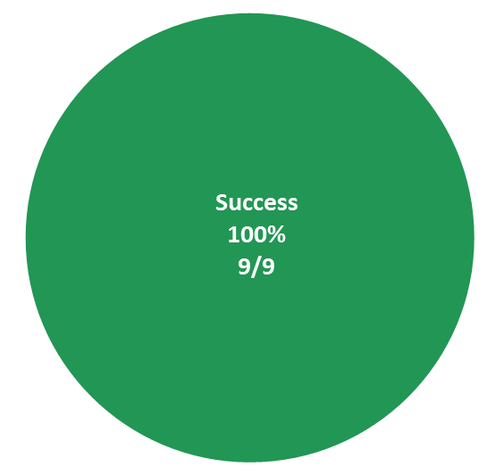
Find a Passport Service Location
Spring 2014
Summer 2015
Spring 2016
Success
53%
Success
93%

Slide 10
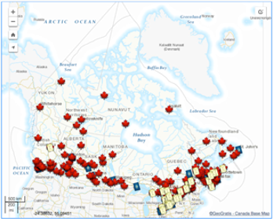
Success
53%
Success
93%

Slide 11

Success
53%
Success
93%

Slide 12


Slide 13
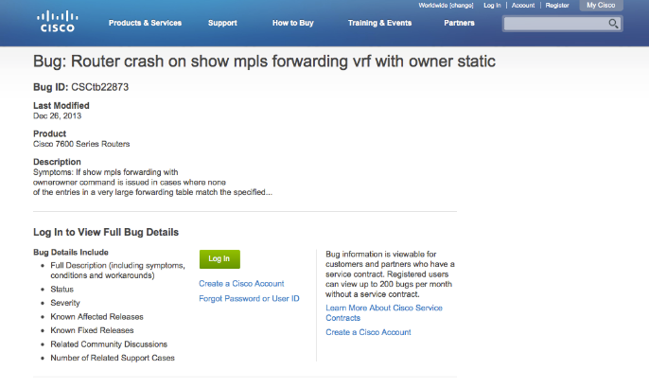
Cisco bug search
Ran a pilot test to simulate a possible solution. It worked!
Solution implemented
Notes:
7. TPI is a surveillance tool. In order to routinely monitor the performance of the site, we have decided to conduct a Support TPI study every quarter. Therefore, we have selected 10 support tasks that are tested each time so that we can identify improvement or relapses against a benchmark. These make up the Support TPI.
The support TPI is overall TPI score is roughly an average of the score of all 10 tasks.

Slide 14


Ongoing management metric: Success & time
TIME

Slide 15
Create a guest account
Notes:
7. TPI is a surveillance tool. In order to routinely monitor the performance of the site, we have decided to conduct a Support TPI study every quarter. Therefore, we have selected 10 support tasks that are tested each time so that we can identify improvement or relapses against a benchmark. These make up the Support TPI.
The support TPI is overall TPI score is roughly an average of the score of all 10 tasks.

Slide 16
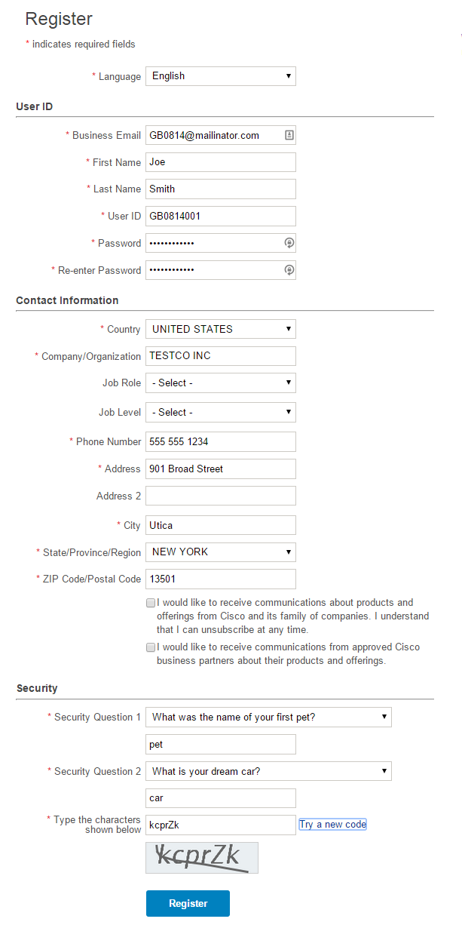
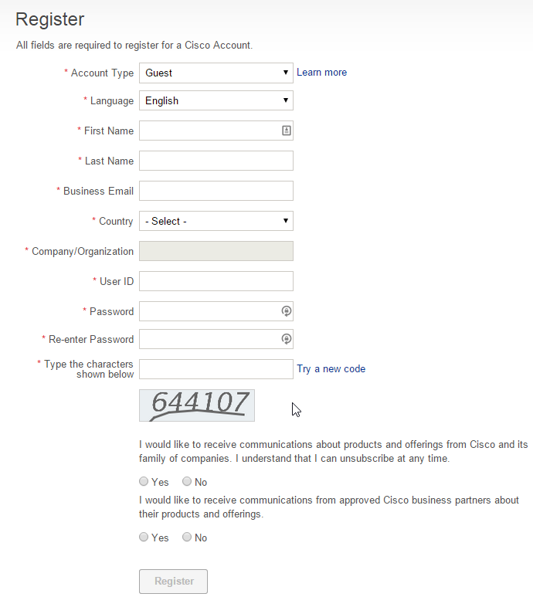
Dec 2014
Jun 2015
22 mandatory and optional fields
11 mandatory fields

Slide 17
Registration Support Tickets

Slide 18
Canadian government Task Performance Indicator
Country | Success | Time
Jobs | 60% | 120
Business | 56% | 110
Benefits | 65% | 100
Immigration | 55% | 130
Health | 56% | 125
Taxes | 69% | 95
Environment | 68% | 90
Culture | 60% | 105
Policing | 62% | 100

Slide 19
Case Studies

Slide 20
Checking Weather

Slide 21
Weather Alerts success rate

Slide 22
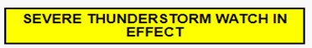
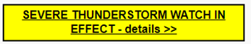
Weather alert success rate
25%
75%

Slide 23
Hourly forecasts

Slide 24
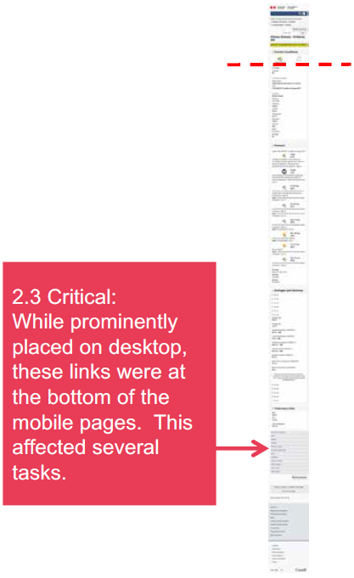
Hourly forecasts - BEFORE

Slide 25
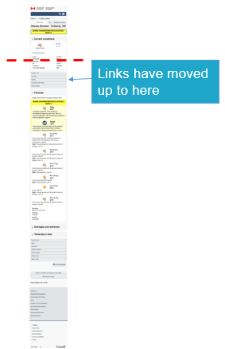
Hourly forecasts - AFTER

Slide 26
Starting a business

Slide 27
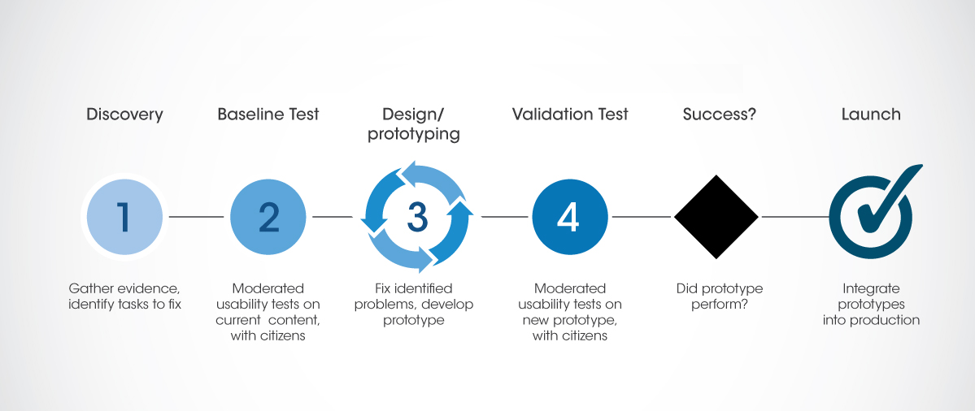
Task Optimization Process

Slide 28
Optimization target:
+15% task success and findability rates, with overall reduction in time-on-task
28

Slide 29
Optimization target:
On average, task findability increased by 28%, from 67% to 95%
29

Slide 30
Quick Facts
Optimization target:
On average, time on task was reduced by 15%
30

Slide 31
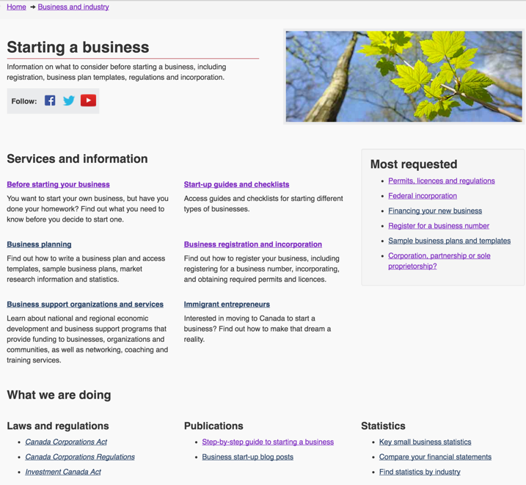
BEFORE

Slide 32
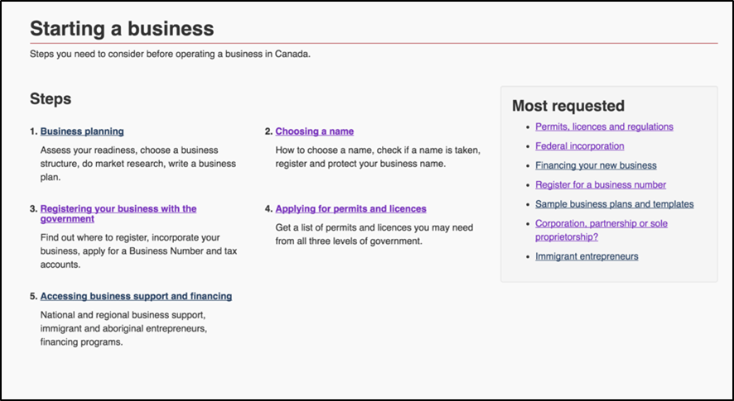
AFTER

Slide 33
Name your business success rate

Slide 34
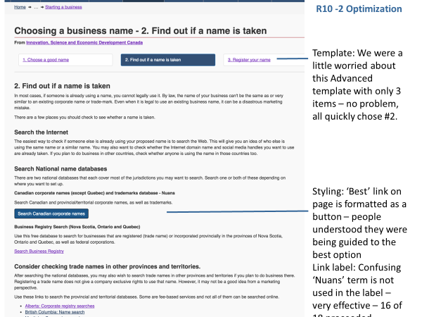
Name your business – jargon
NUANS?
Search Canadian Corporate Names

Slide 35
Visiting Canada

Slide 36
Find out what I need to come to Canada

Slide 37
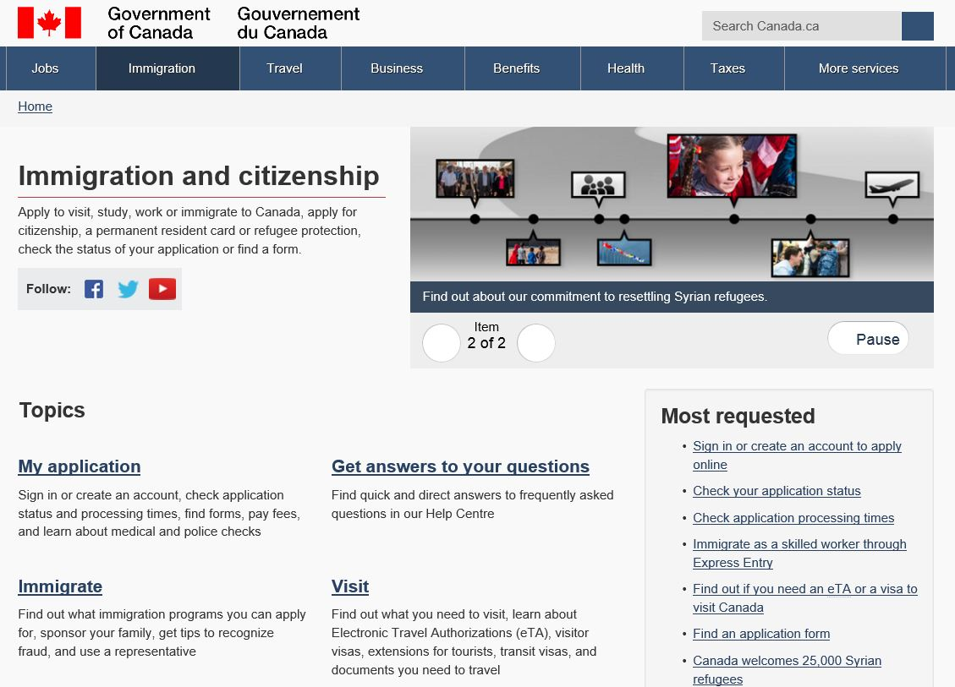
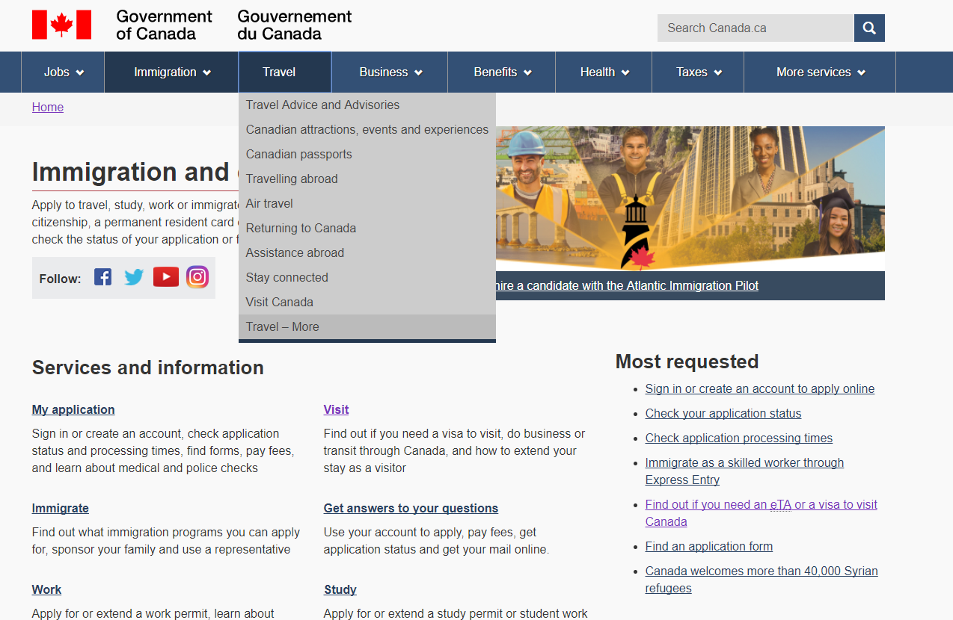
Immigration and Citizenship theme landing page
Before
After
The link to the Visit Canada topic was moved up and crosslink was added to Travel theme to improve findability.

Slide 38
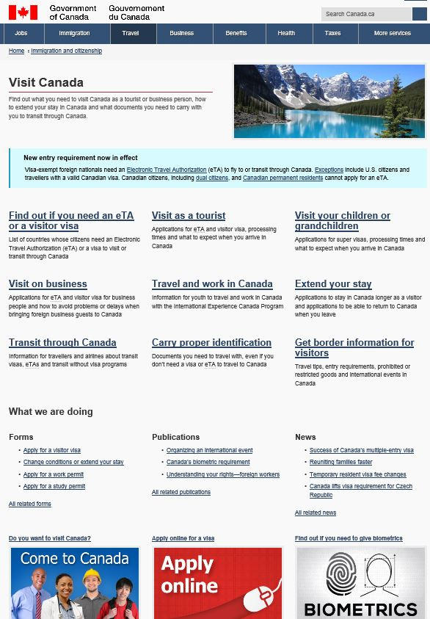
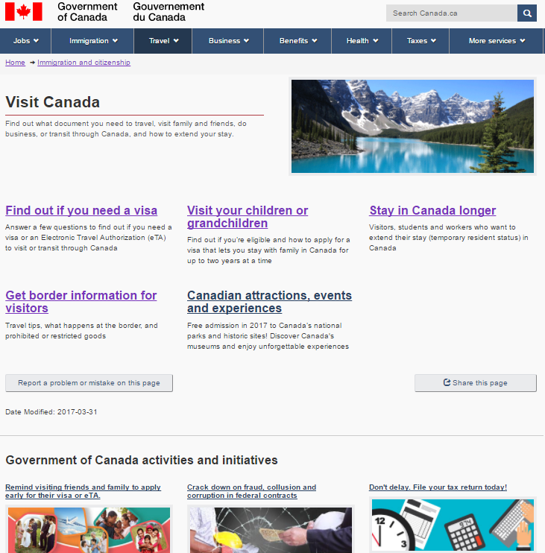
Visit Canada topic page
Before
After
4 confusing or duplicative links removed
Redundant and non-contextual promotions removed to improve task findability.

Slide 39
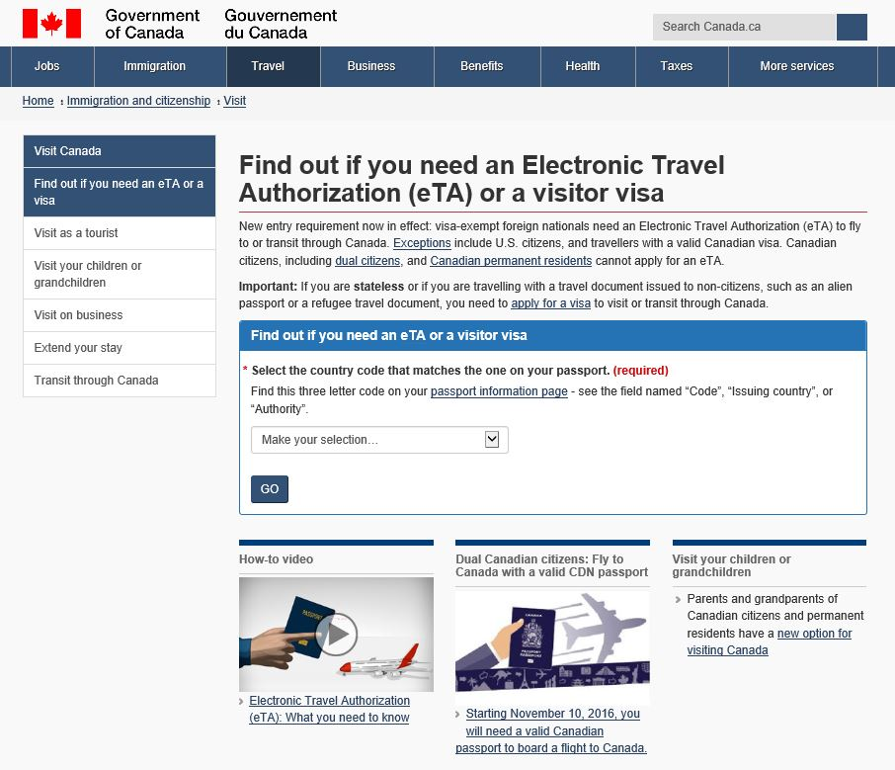
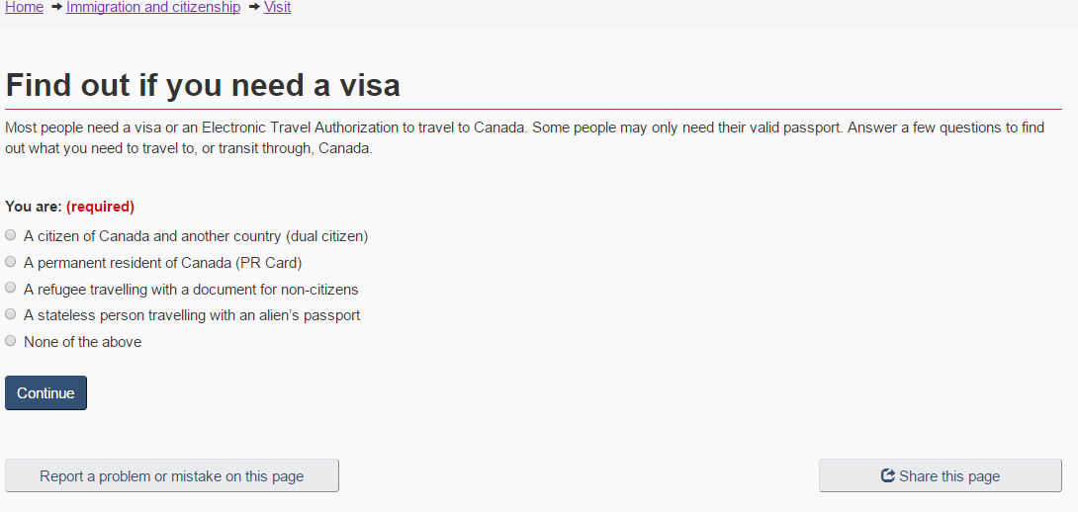
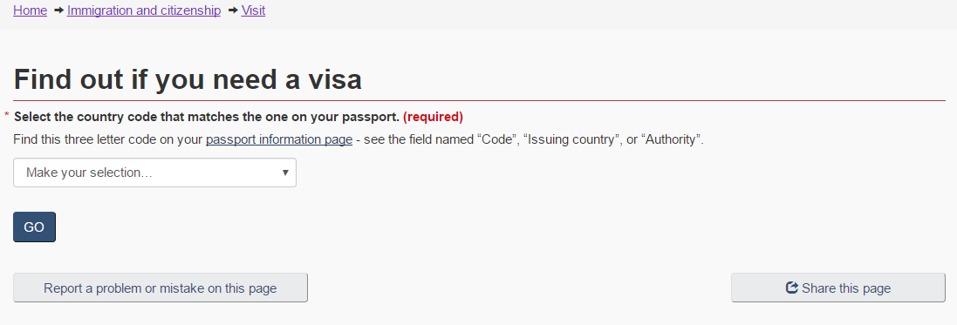
Find out if you need a visa page
Before
After
Blocks of text were replaced with questions that lead people to the answer they need

Slide 40
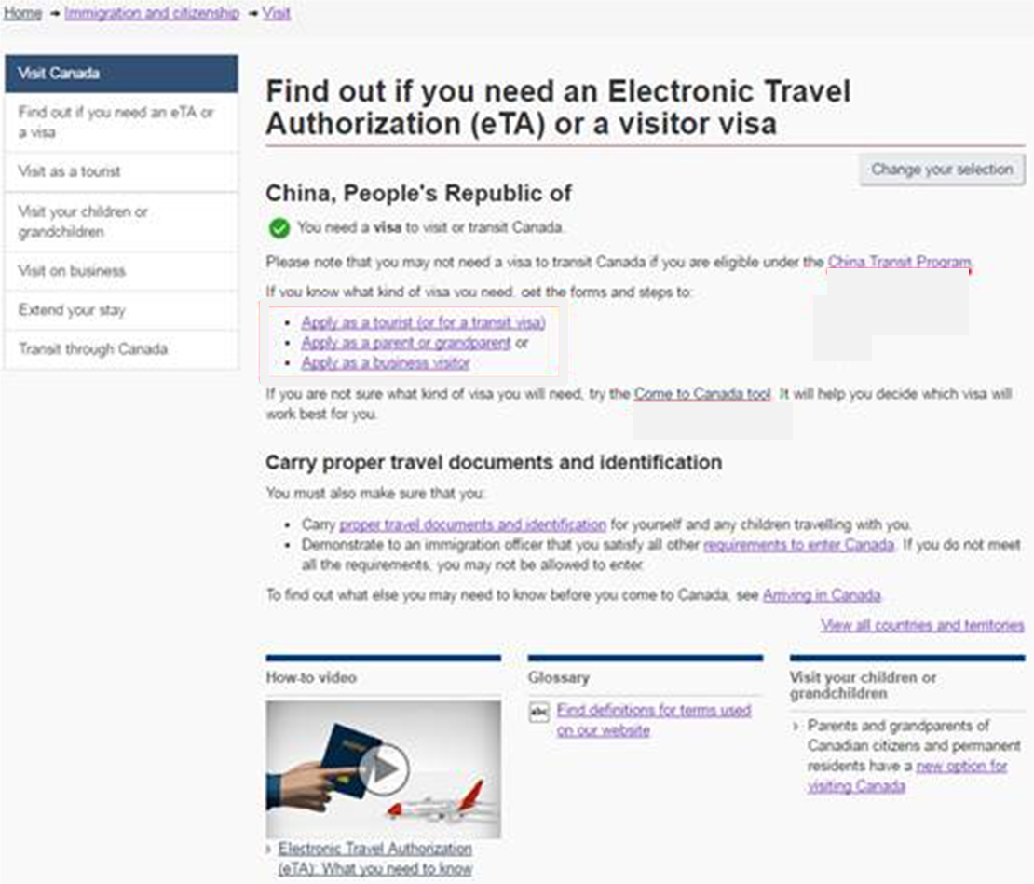
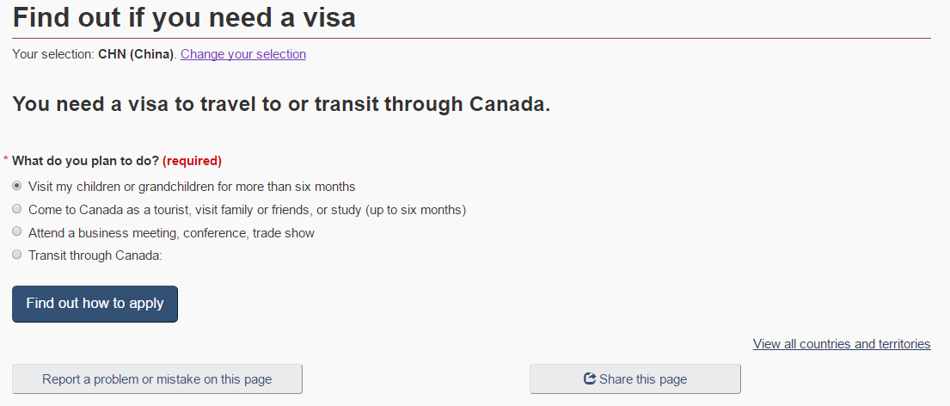
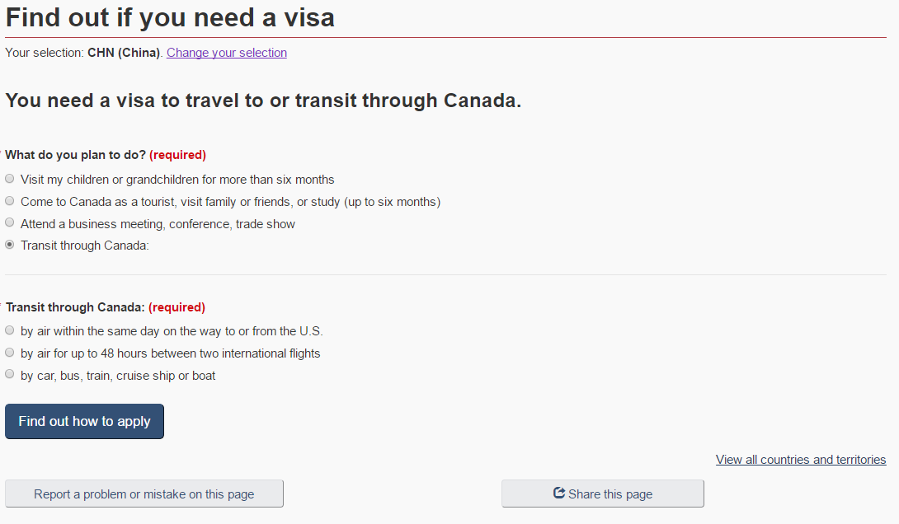
You need a Visa - answer page
Before
After
If “Transit through Canada” is selected
The left-hand navigation box removed, since testing showed that it often drew users away from finding the correct answer.

Slide 41
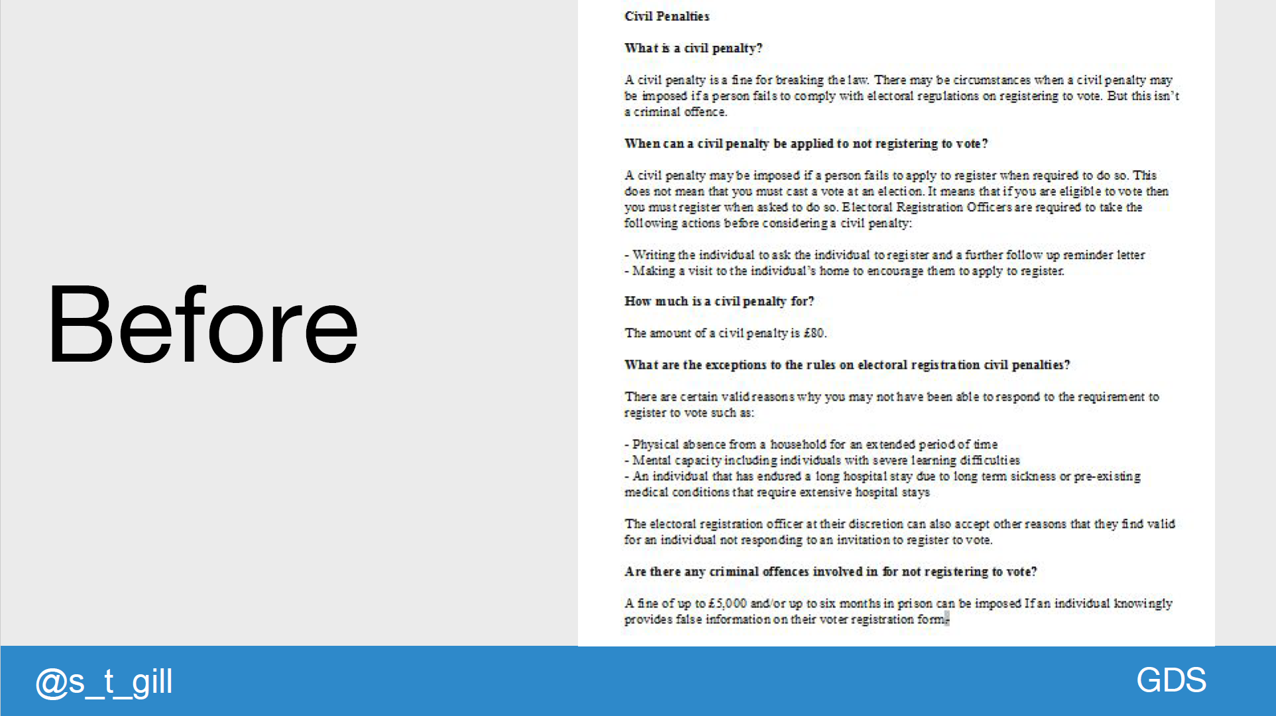

Slide 42
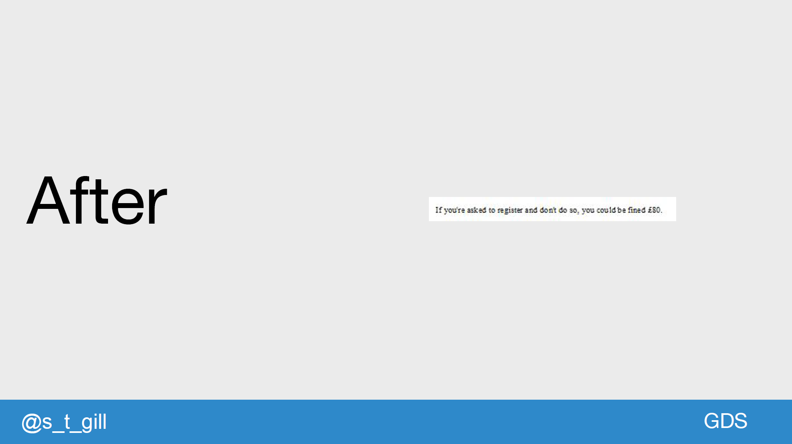

Slide 43
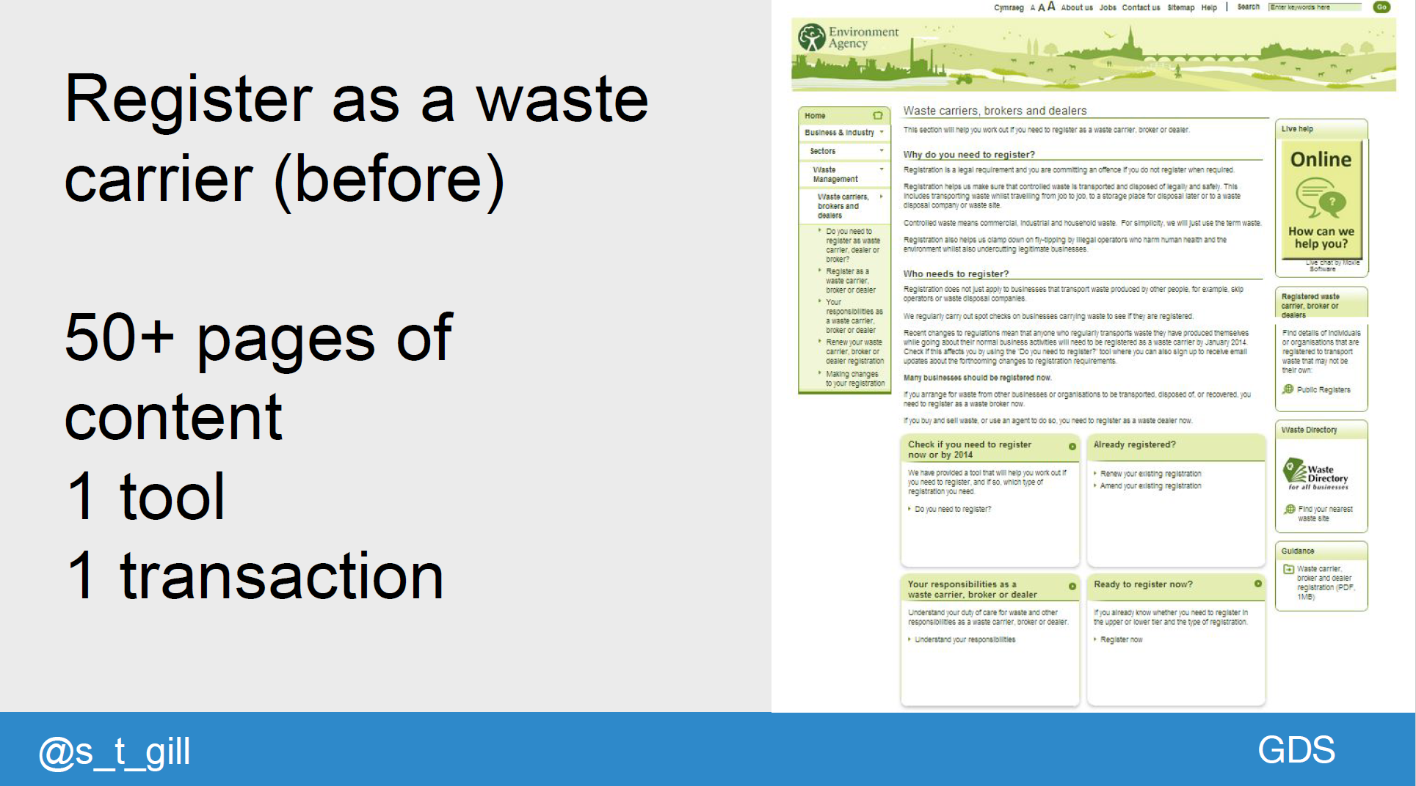

Slide 44
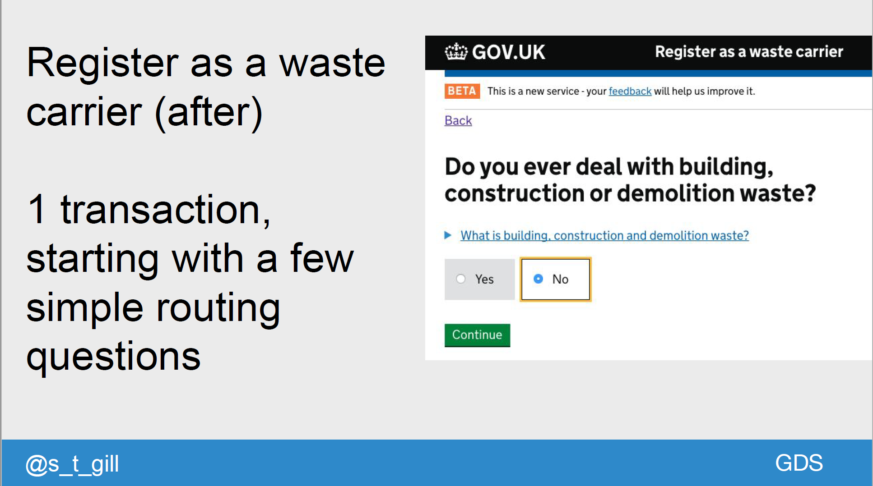

Slide 45
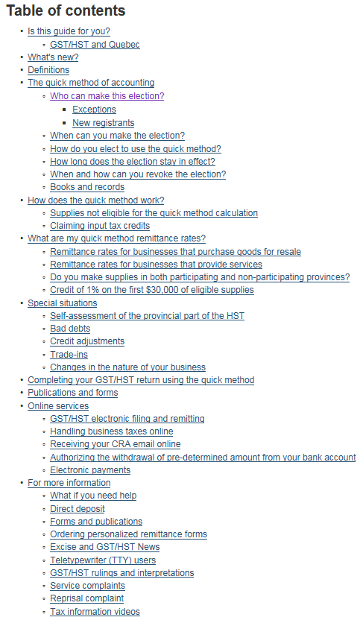
GST QUICK METHOD – before redesign

Slide 46
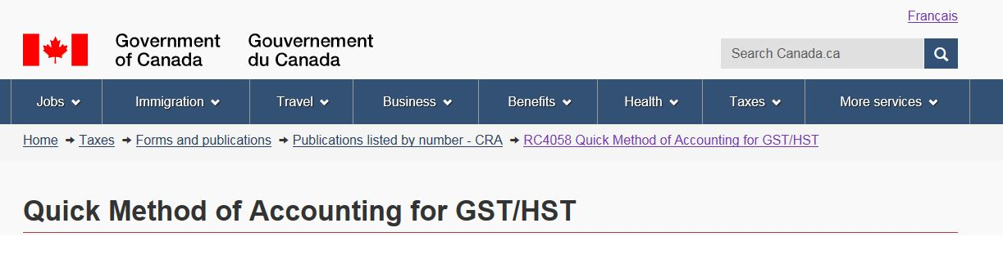
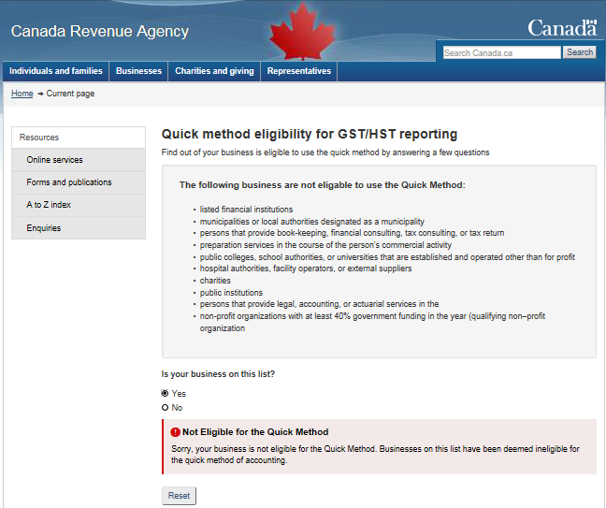

Find out if your business is eligible to use the quick method by answering a few questions
1
2
3
4
1
2
3
4
The following businesses are not eligible to use the Quick Method:
)

Slide 47
Task success improvements
93 days
Today
30 days
67 days

Slide 48
Implementation time after changes had been approved
93 days
Today
30 days
67 days
Months to implement

Slide 49
Government recruitment

Slide 50
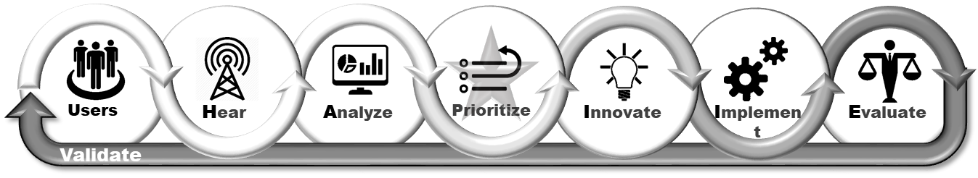

Slide 51
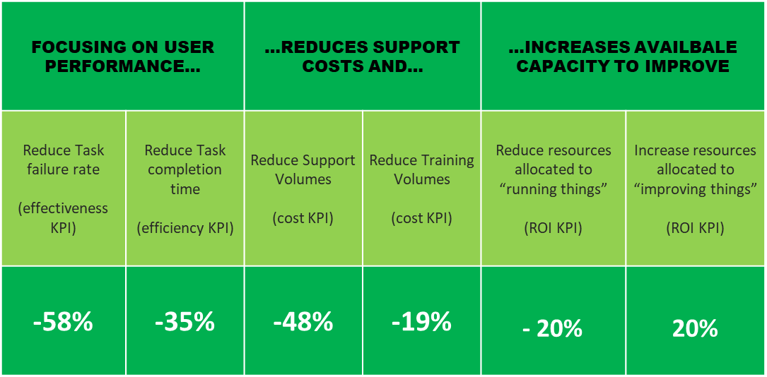

Slide 52
Discussion

Slide 53
What’s the biggest lessons learned as a result of the engagements?
How do we increase agility? How do we move faster, iterate faster?
Who owns and is responsible for the metrics of task success and time-on-task?

Slide 54
Thank you
WWW.
customercarewords.com
gerry@customercarewords.com
+353 87 238 6136
@gerrymcgovern

